Slide 1







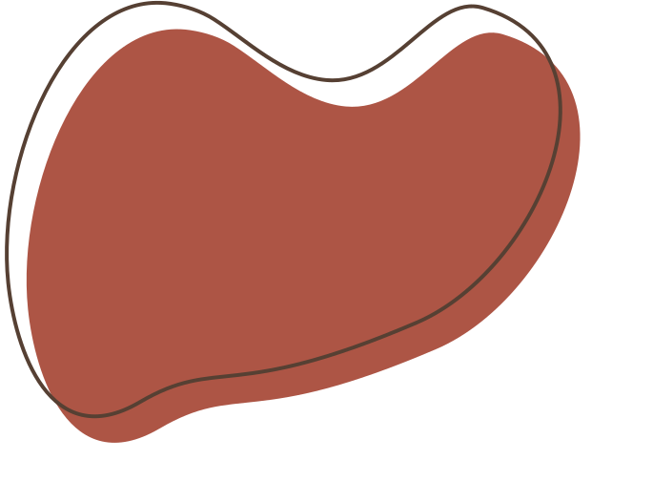
Exploring C++ Sorting Algorithms
Lectured by Y. Sokha
Code compilation by Adam

Slide 2

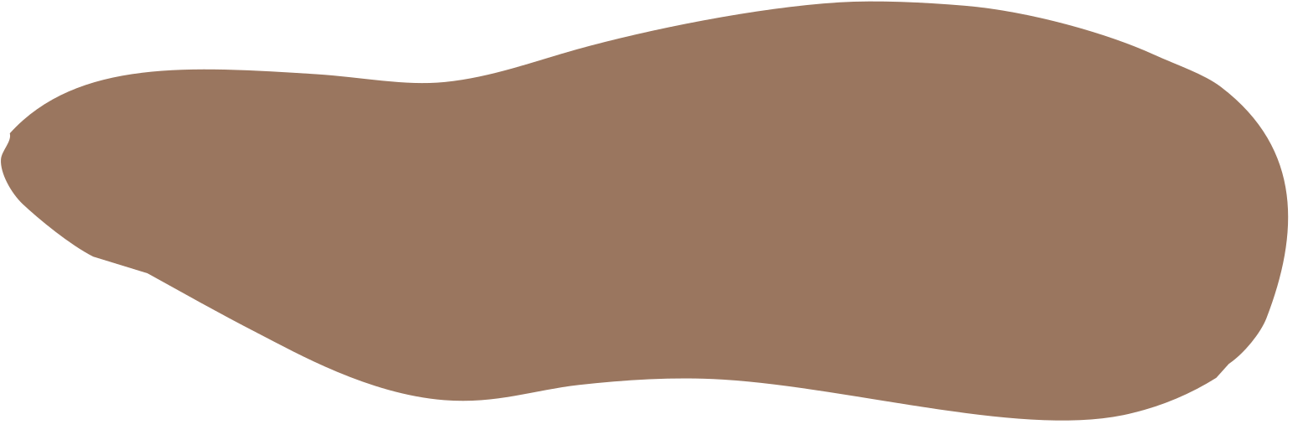


Table of contents
Introduction
Sort Methods
Why Sorting Algorithms Matter
Bubble Sort
Insertion Sort
Selection Sort
Merge Sort
Quicksort
Performance Comparison
Best Practices
Conclusion

Slide 3

Introduction
Sorting algorithms play a crucial role in computer science and programming, including C++. Sorting is the process of arranging elements in a specific order, typically in ascending or descending order, to make data more accessible and easier to work with.
It helps us in various tasks such as:
Data Organization
Search Efficiency
Algorithm Performance
Enhanced Readability
Optimizing Memory Access
Algorithm Learning
Application in Various Fields
Data Presentation

Slide 4

2. Sort Methods
In this presentation, we will diving in depths into the following major 5 sorting
algorithms:
Bubble sort.
Insertion sort.
Selection sort.
Merge sort.
Quicksort.
Heapsort.

Slide 5

3. Why do they matter?
Sorting algorithms play a crucial role in a variety of real-world scenarios, contributing to the efficiency and effectiveness of numerous applications. Here are explanations of the role of sorting algorithms and some real-world scenarios where they are commonly applied:

Slide 6



Database Management
Role:
Sorting is essential for database management systems to efficiently retrieve and organize data. It helps in speeding up search operations, facilitating the quick retrieval of information.
Real-world Scenario:
In a customer database, sorting by customer name or ID allows for faster searches and improved data retrieval, making it easier to locate and manage customer records.

Slide 7

Web Search Engines
Role:
Sorting algorithms are used to organize search results. Search engines can quickly present relevant results by sorting them based on relevance, popularity, or other factors.
Real-world Scenario:
When you perform a web search, the search engine uses sorting algorithms to rank and display results based on relevance and other criteria, providing users with the most useful information first.

Slide 8

E-commerce Applications
Role:
Sorting is crucial in e-commerce platforms for arranging product listings. It helps users find products more easily by sorting them based on price, popularity, or other relevant attributes.
Real-world Scenario:
On an online shopping website, sorting products by price or customer ratings enables users to quickly identify and purchase the products that best meet their criteria.

Slide 9

Operating Systems
Role:
Operating systems often use sorting algorithms for file management. Files in a directory can be sorted based on various attributes such as name, size, or date.
Real-world Scenario:
In a file explorer, the ability to sort files by name, size, or date makes it easier for users to locate and manage their files, especially in directories with a large number of files.

Slide 10

Telecommunication Networks
Role:
Sorting is used in the processing of call records, routing information, and network optimization. It helps in quickly identifying and handling large volumes of data.
Real-world Scenario:
Telecommunication companies use sorting algorithms to organize and process call records efficiently. This aids in tasks such as billing, network optimization, and identifying usage patterns.

Slide 11

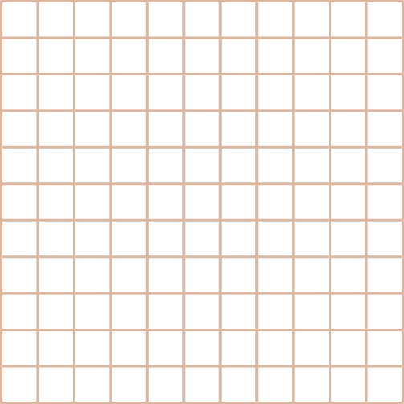



4. Bubble sort
Since we have learnt the importance of sorting algorithm, let’s have a look
at our first sorting algorithm, written in C++. Bubble sort!
Bubble sort is a simple sorting algorithm that works by repeatedly swapping adjacent elements if they are in the wrong order. It gets its name because smaller elements "bubble" their way to the top of the list, similar to how bubbles rise to the surface of a liquid.
Let’s open your IDE or Editor and we will start coding!

Slide 12
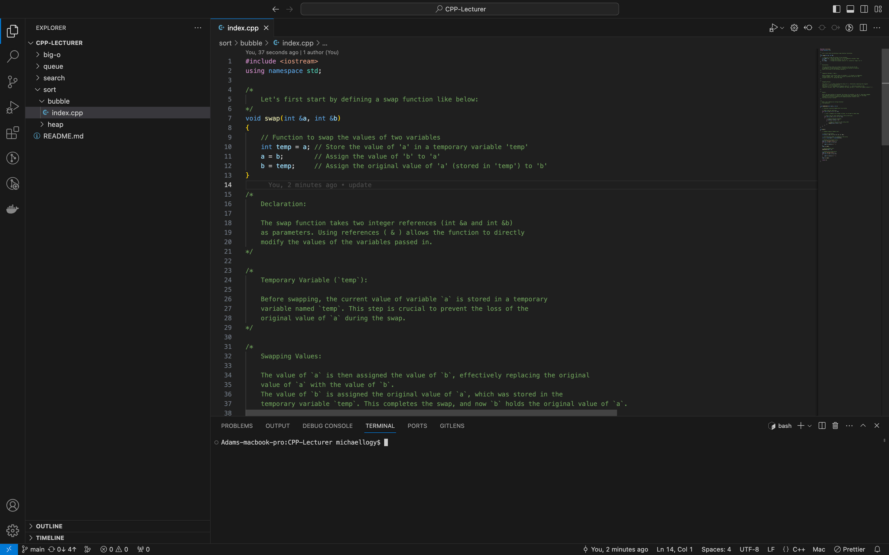
Swap function declaration:

Slide 13
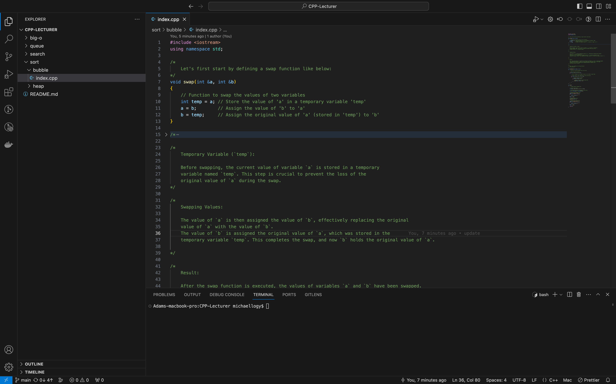
Swap function declaration:

Slide 14
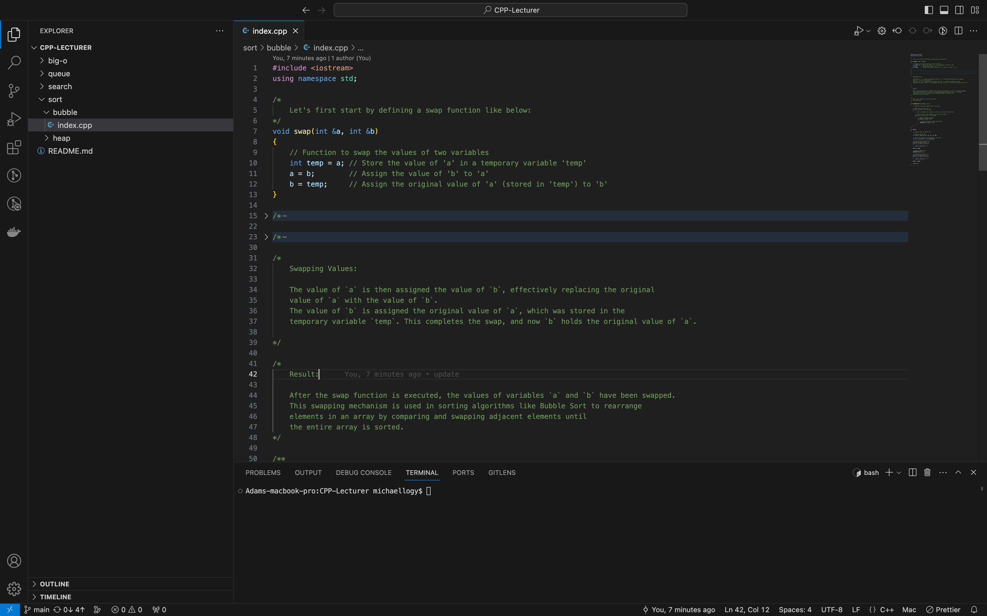
Swap function declaration:

Slide 15
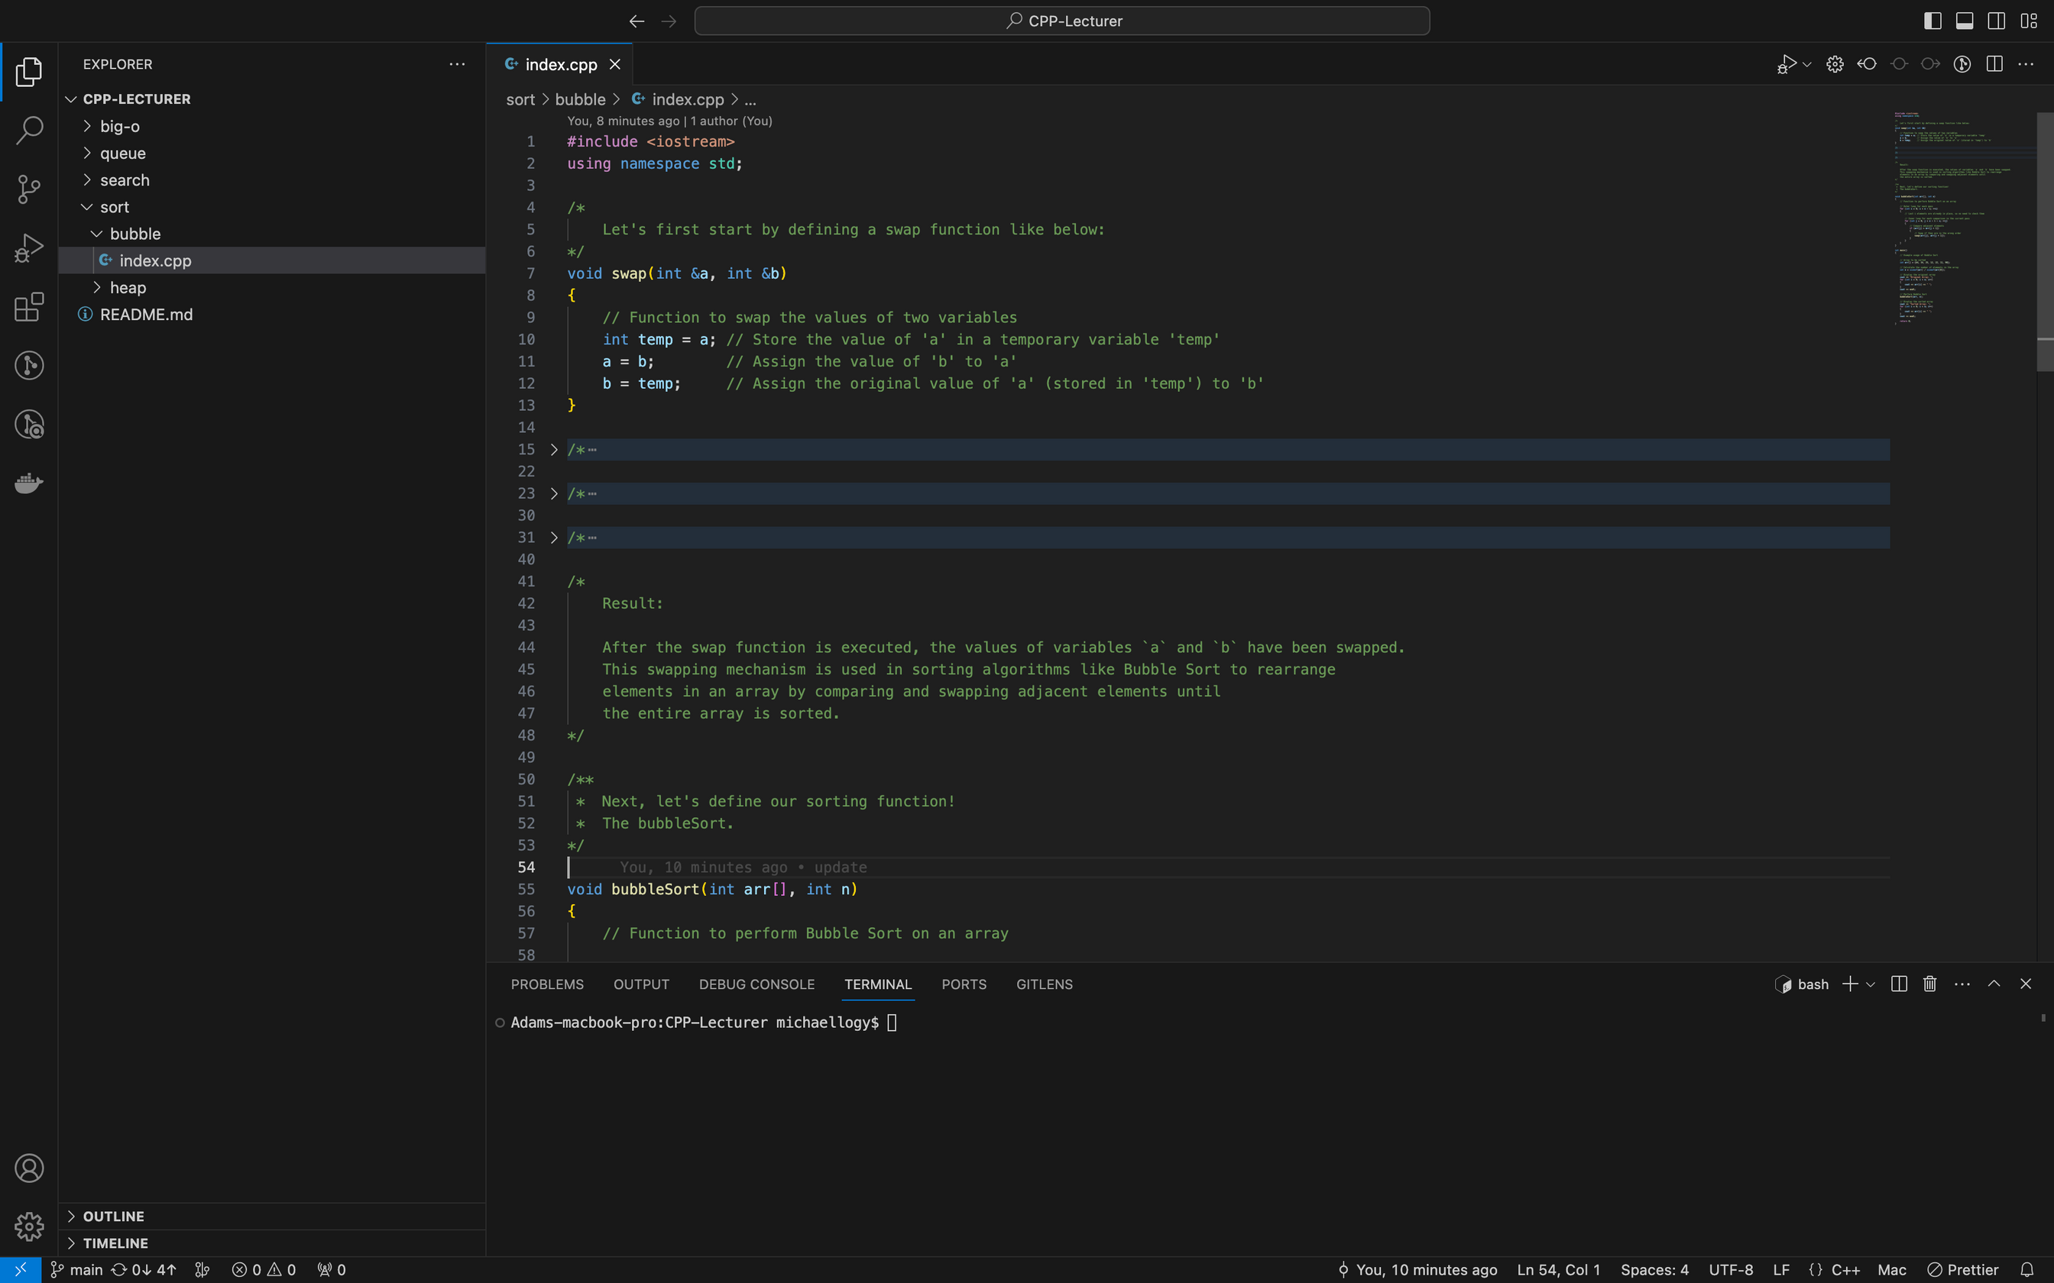
Swap function declaration:

Slide 16
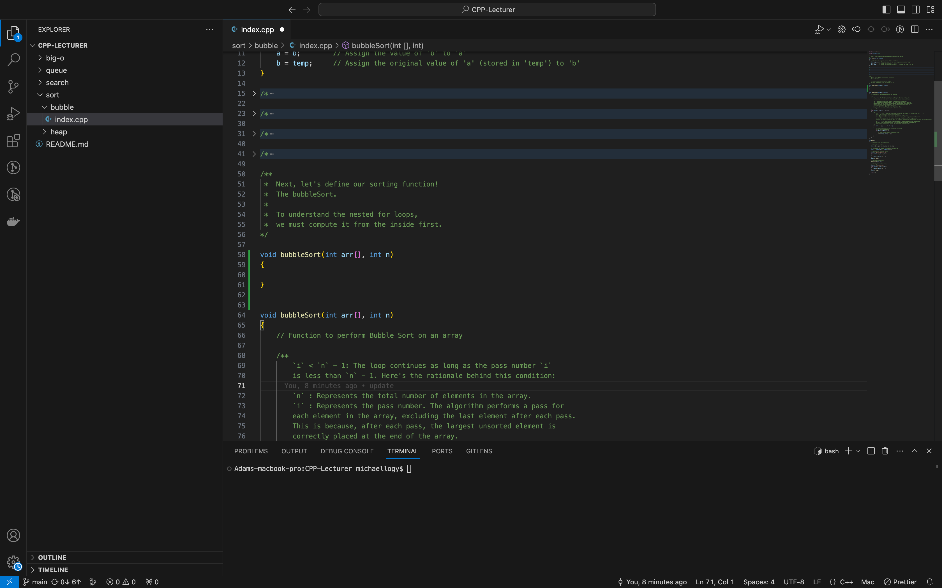
Sort function declaration:

Slide 17
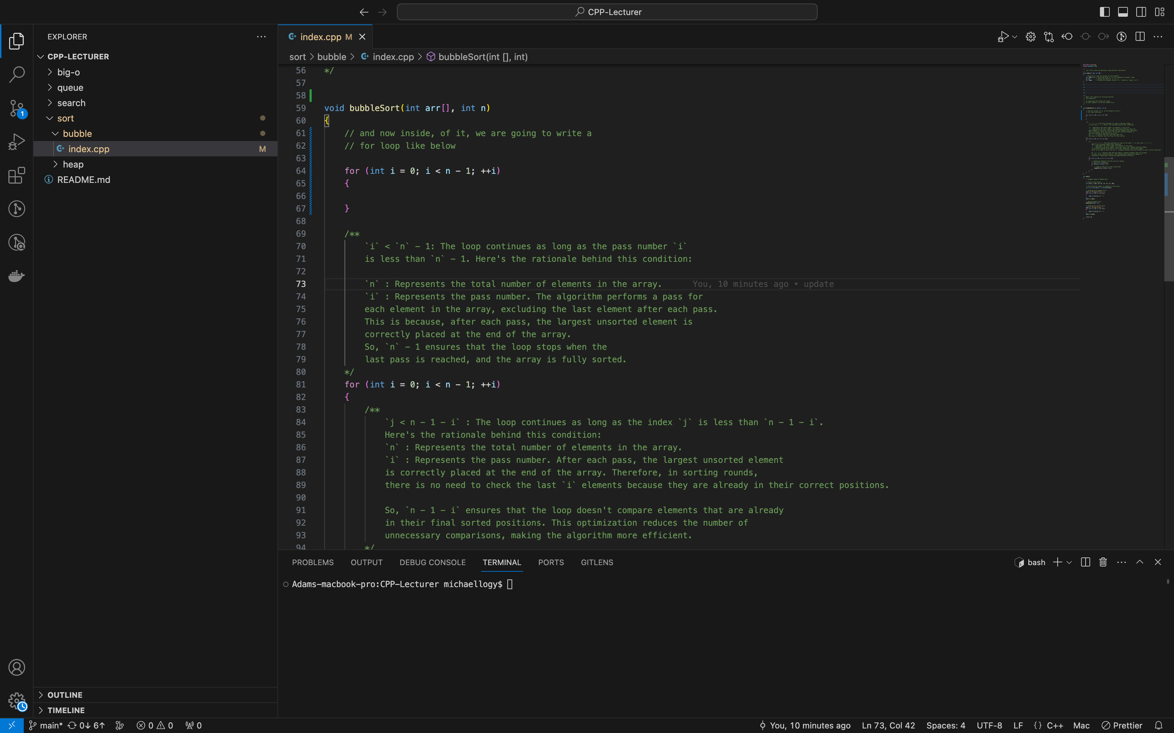
Sort function declaration:

Slide 18
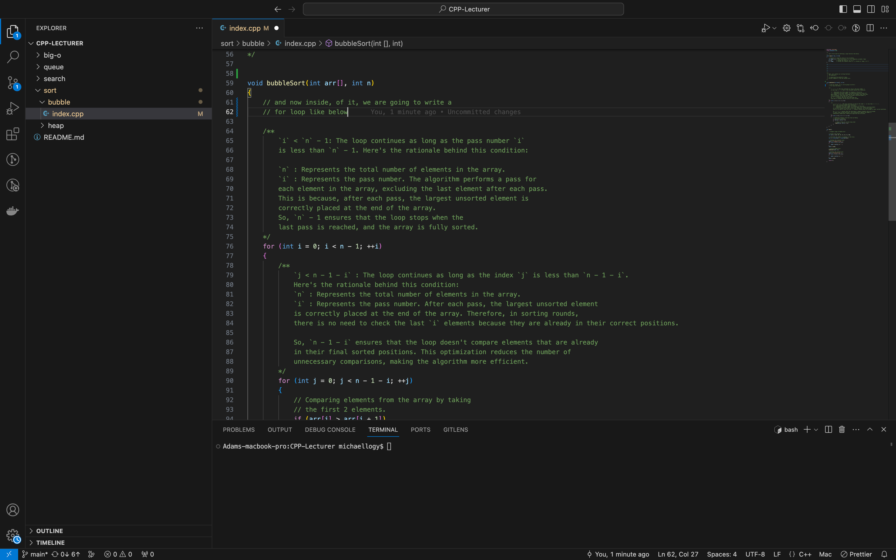
Sort function declaration:

Slide 19
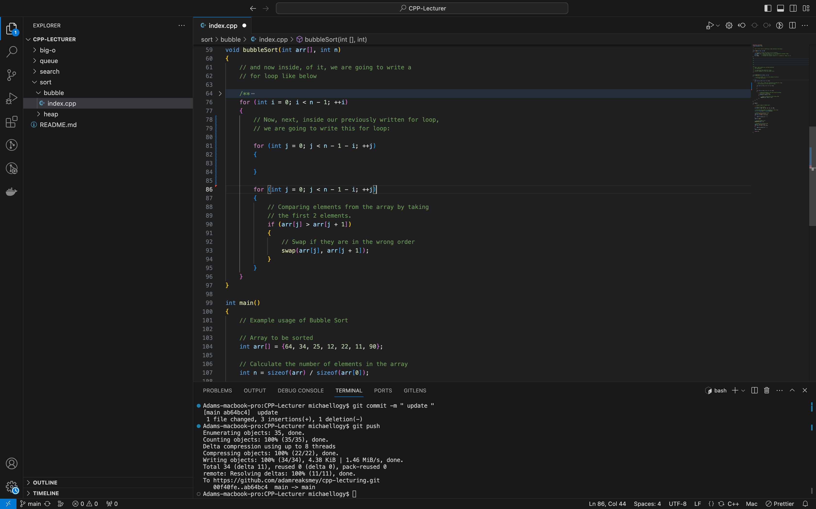
Sort function declaration:

Slide 20
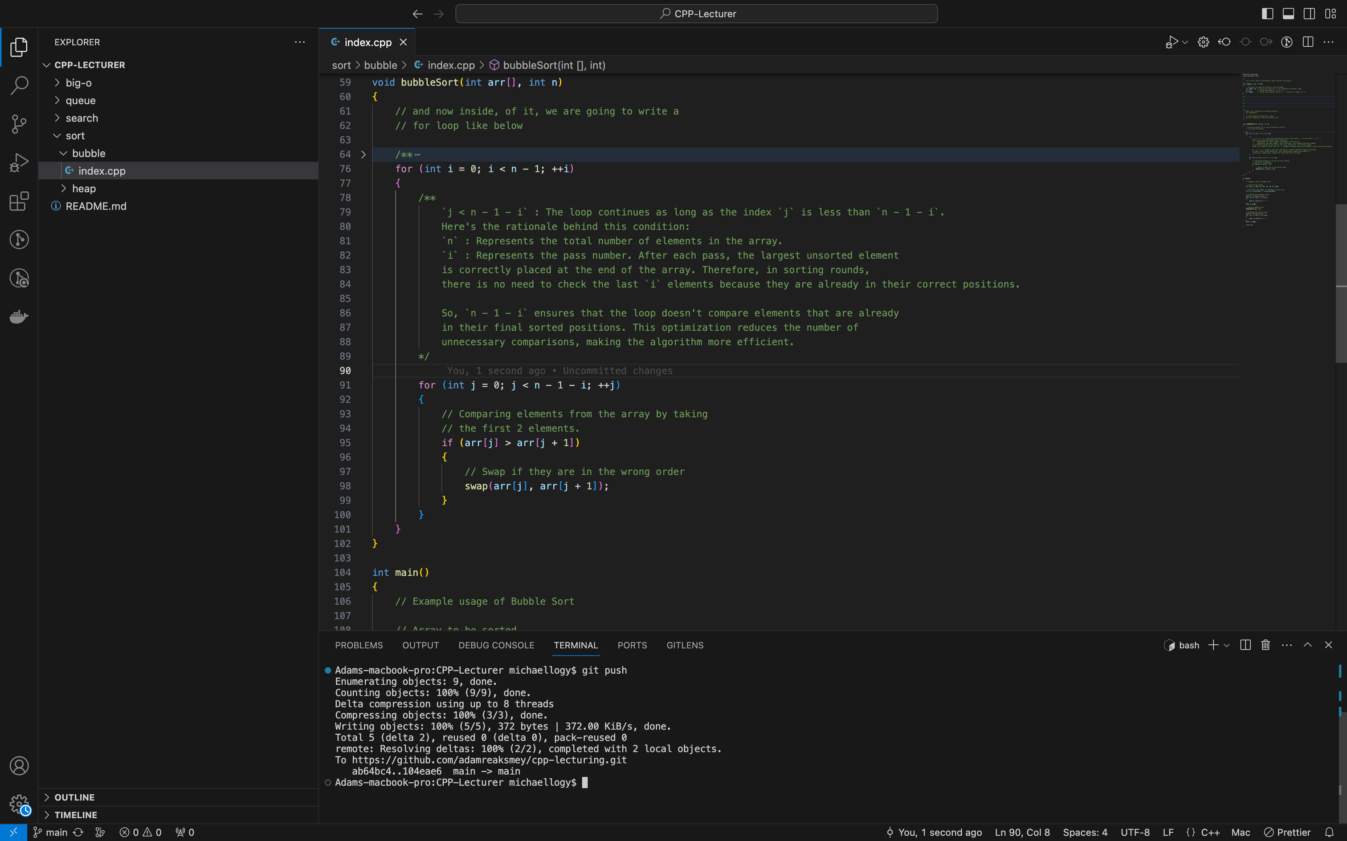
Sort function declaration:

Slide 21
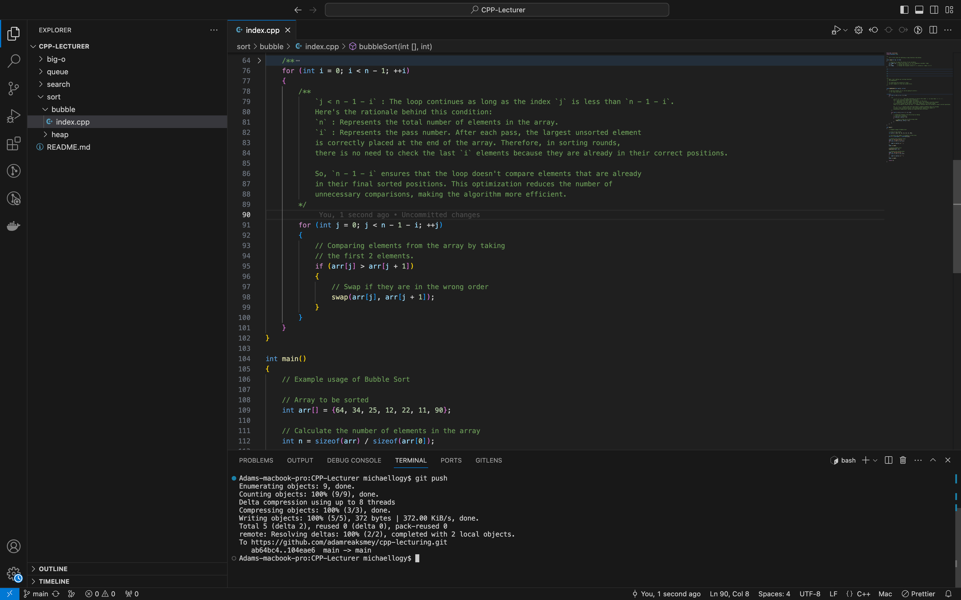
Sort function declaration:
Last step, the swap function inside our last for loop before we
closed our bubbleSort() function!

Slide 22
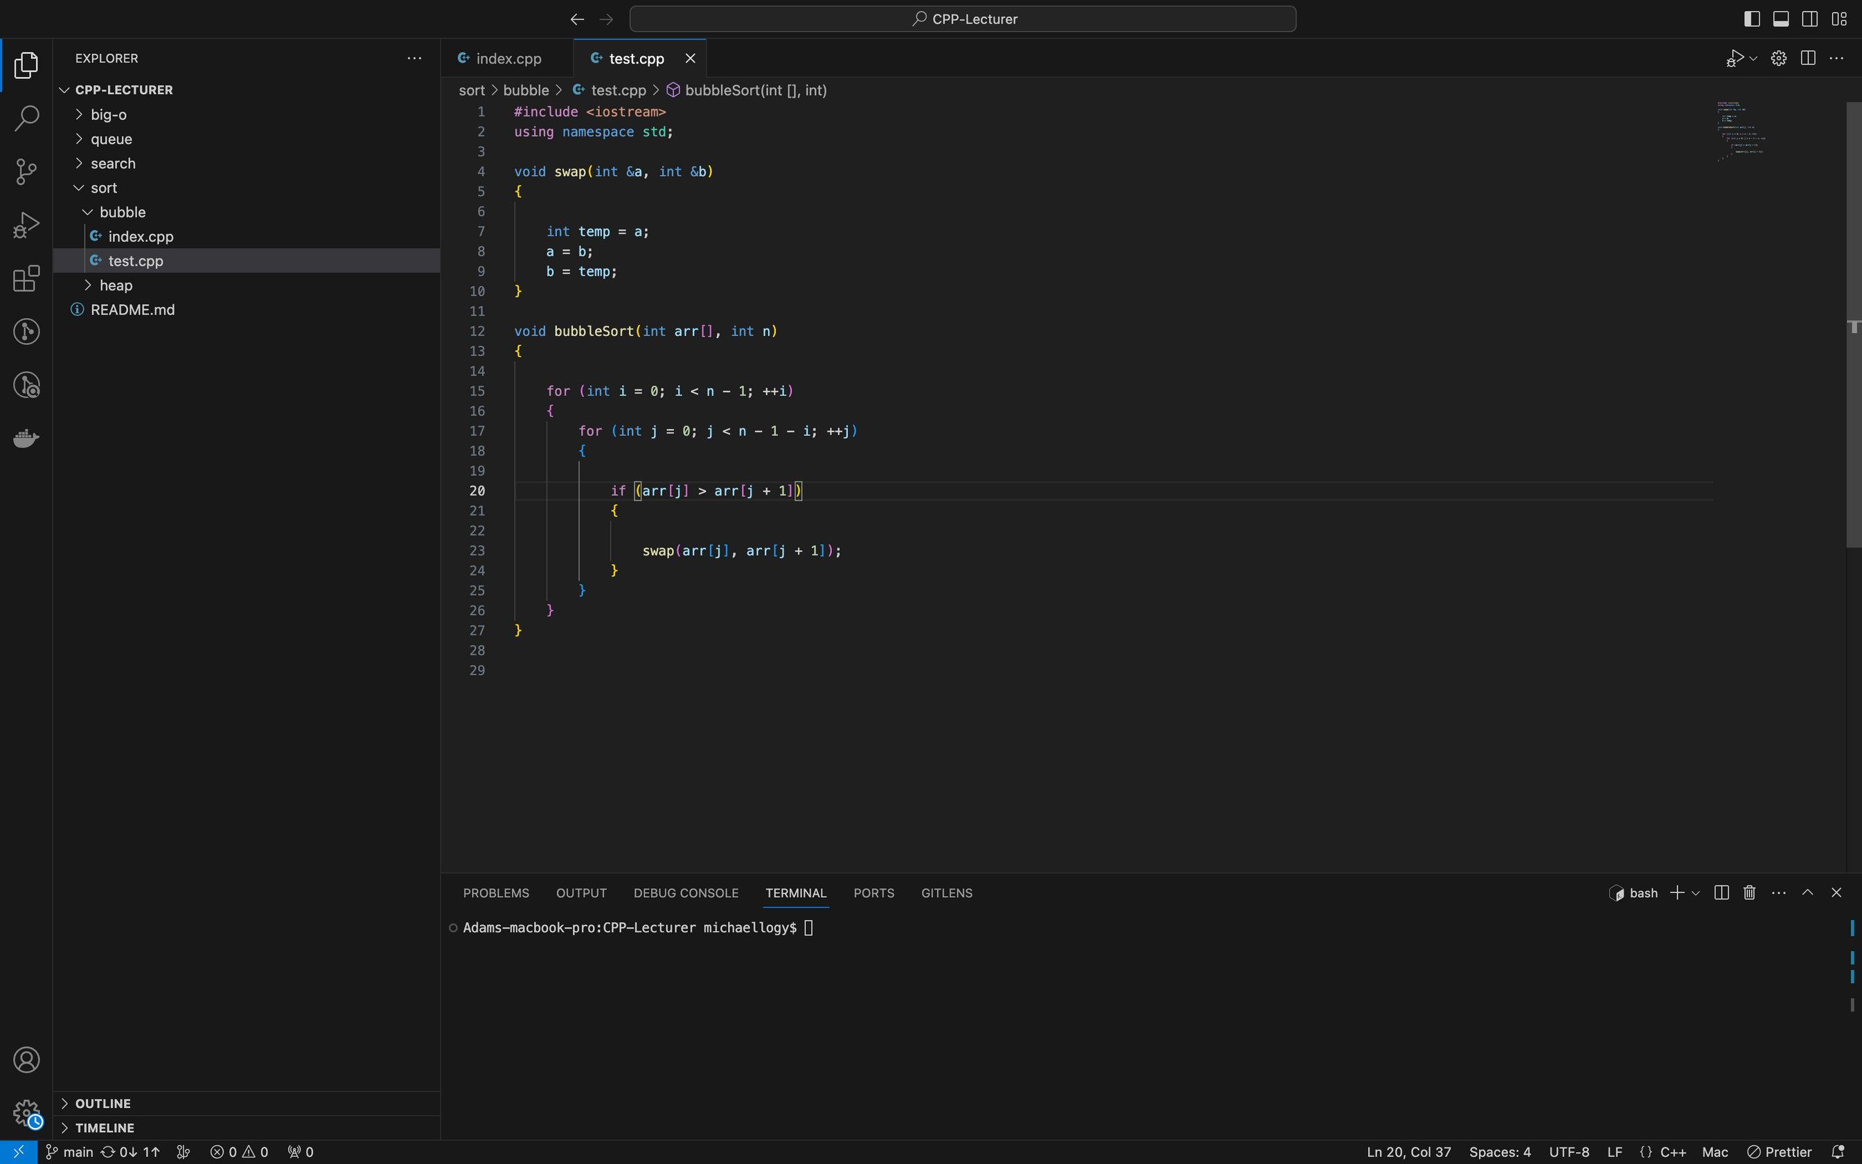
Completion:
Finally, if written correctly, your whole code should look something like below:

Slide 23
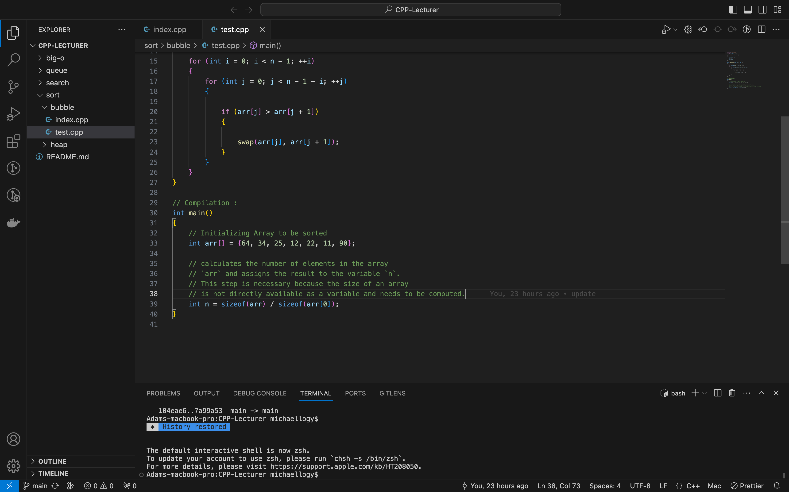
Compilation:
Let magic discloses:

Slide 24
Compilation:
Let magic discloses:

Slide 25
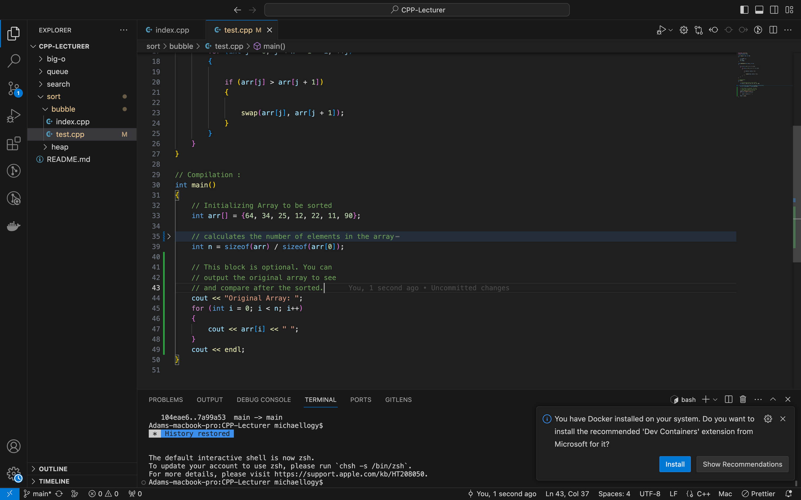
Compilation:
Let magic discloses:

Slide 26
Compilation:
Let magic discloses:

Slide 27
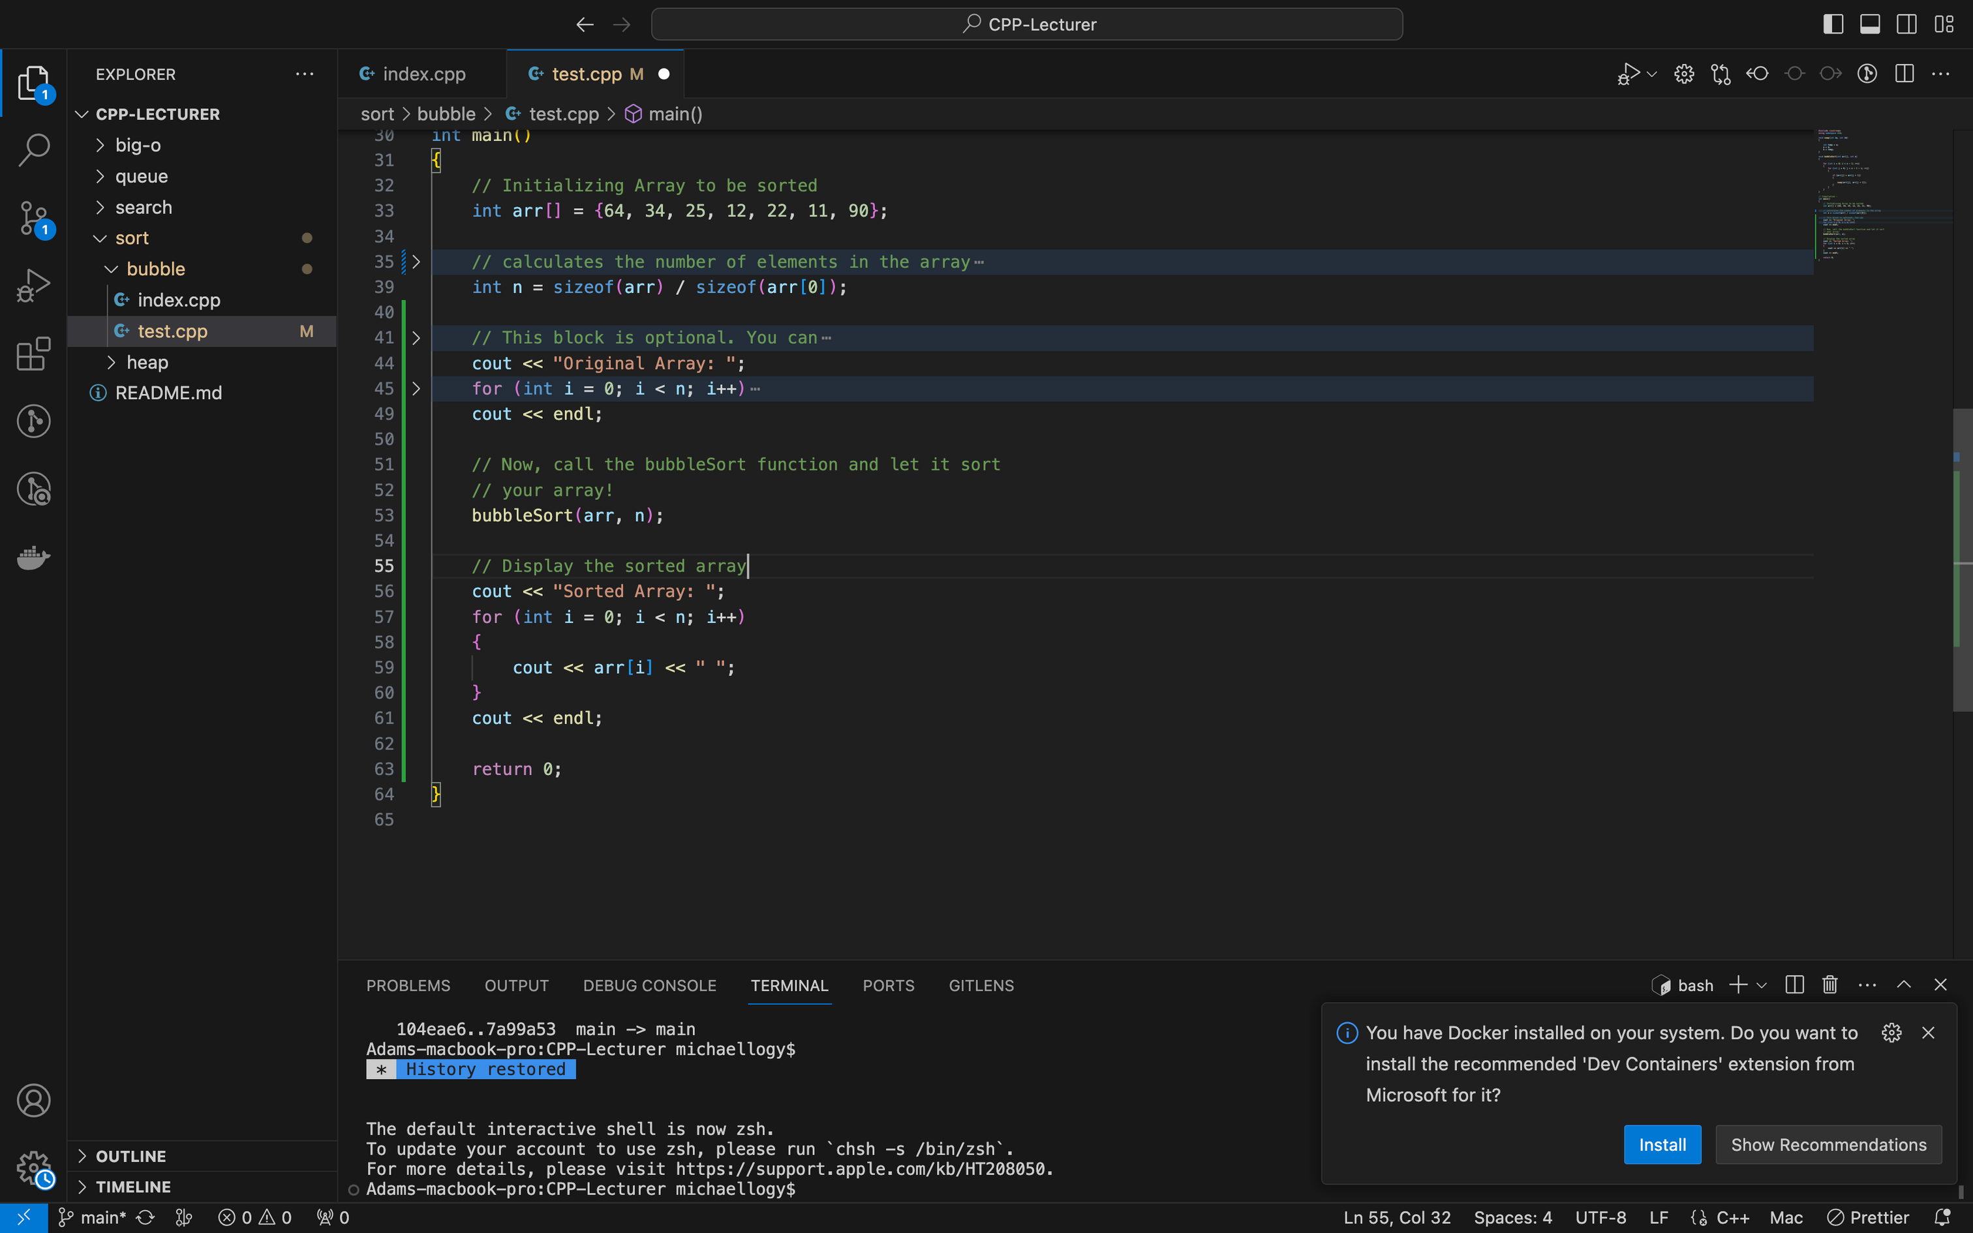
Compilation:
Let magic discloses:
Sorted Array: 11 12 22 25 34 64 90

Slide 28
5. Insertion sort
Insertion sort is another simple sorting algorithm that works by dividing the input list into two parts: a sorted portion and an unsorted portion. The sorted portion begins with only the first element, and the algorithm iterates through the remaining unsorted portion, inserting each element into its correct position within the sorted portion.

Slide 29

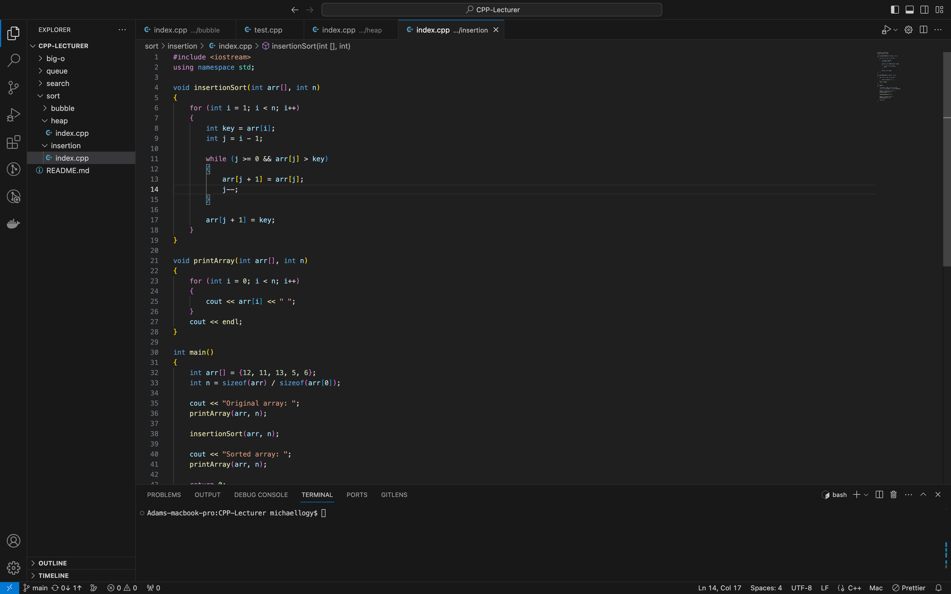
Function declaration:
Let’s first by initializing our code below:
1
The insertionSort function takes an array arr and its size n as input and performs the Insertion Sort algorithm.
The algorithm starts with the second element (index 1) and iterates through the array. For each element, it stores the value in the key variable and initializes j as the previous index (i - 1).
The function enters a while loop that continues until j is greater than or equal to 0 and the element at position j is greater than the key. Inside the loop, it shifts the elements to the right, moving each element one position up, to make room for the key.
Once the loop terminates, it means that the correct position for the key has been found. It assigns the key to the j + 1 position, effectively inserting it into the sorted portion of the array.
1

Slide 30
Function declaration:
Let’s first by initializing our code below:
2
Similar to the previous example, the printArray function is a utility function that takes an array arr and its size n as input. It prints the elements of the array separated by spaces and ends with a newline character.
2

Slide 31
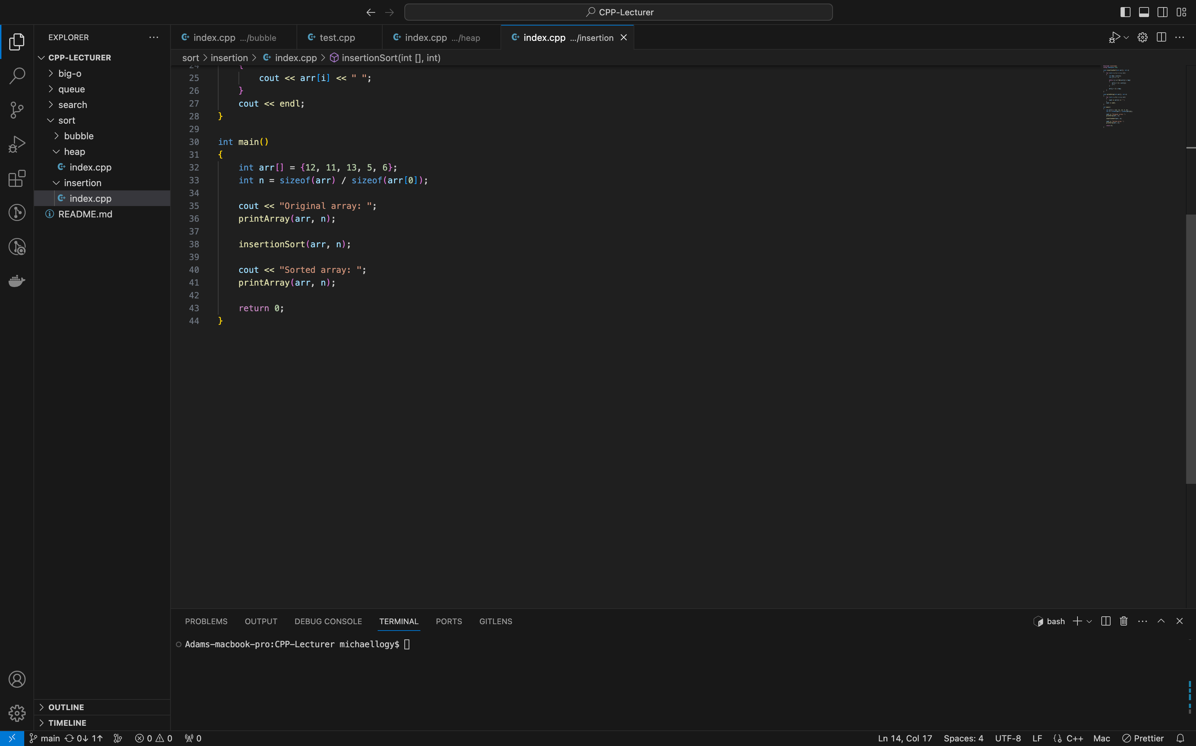
Compilation:
This is relatively short compared to our previous sort function, now let’s compile!
1
Array named arr is declared and initialized with some values. In this example, the array contains the elements 12, 11, 13, 5, and 6.
1
2
2
This line calculates the size of the array arr by dividing the total size of the array (sizeof(arr)) by the size of a single element (sizeof(arr[0])). The result is stored in the variable n, representing the number of elements in the array.
3
4
3
OPTIONAL: This line prints the message "Original array: " to the console using cout. It is followed by a function call to printArray, which prints the elements of arr in their current order.
4
Calling the insertion sort function, this is where the magic happens!

Slide 32
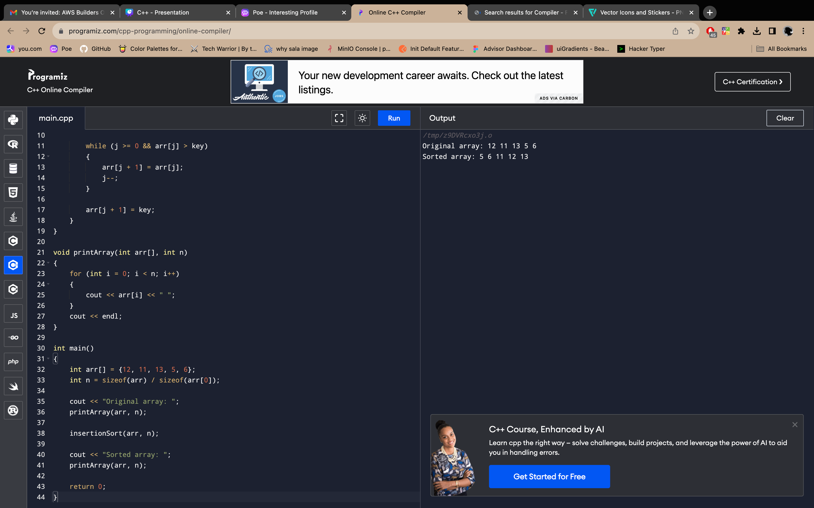
Compilation:
This is relatively short compared to our previous sort function, now let’s compile!
5
This line prints the message "Sorted array: " to the console using cout. It is followed by another function call to printArray, which prints the elements of arr after it has been sorted.
1
2
Results:
3
4
5

Slide 33
6. Selection sort
Selection sort is a simple sorting algorithm that works by repeatedly finding the minimum element from the unsorted portion of the list and swapping it with the first unsorted element. This process is repeated until the entire list becomes sorted.

Slide 34
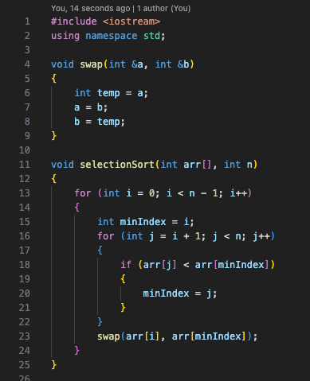
Function declaration:
Let’s first by initializing our code below:
1
Since our selection sort also deals with sorting,
let’s define a sort function for our selection function!
The swap function takes two integer references (int& a and int& b) as parameters. It swaps the values of a and b using a temporary variable temp. This implementation ensures that the values of a and b are correctly exchanged.
1
2
The selectionSort function takes an array arr and its size n as input and performs the Selection Sort algorithm.
The algorithm works by repeatedly finding the minimum element from the unsorted portion of the array and swapping it with the element at the current position. The outer loop iterates through the array from the first element to the second-to-last element.
For each iteration, it initializes minIndex as the current index i.
The inner loop starts from i + 1 and iterates through the remaining unsorted elements. It compares each element with the current minimum element (arr[minIndex]) and updates minIndex if a smaller element is found.
After finding the minimum element in the inner loop, it performs a swap between the current element at index i and the minimum element at minIndex.
2

Slide 35
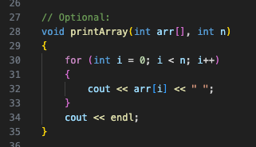
Function declaration:
Next step:
For this block of code, this is optional but during our first practice, it’s a very good thing to have this function so we can compare our array, before and after being sorted!

Slide 36
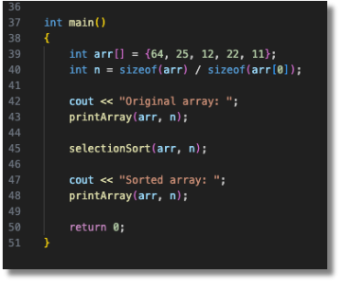
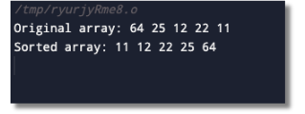
Compilation:
Let the magic discloses!
Result:
if written correctly, your results should be shown like below!
1
1
2
2

Slide 37
7. Merge sort
Merge Sort is a sorting algorithm that follows a divide-and-conquer approach. The main idea behind Merge Sort is to divide the unsorted list repeatedly into smaller sublists until each sublist contains only one element. Then, it merges these smaller sublists back together in a sorted manner until the entire list is sorted.

Slide 38
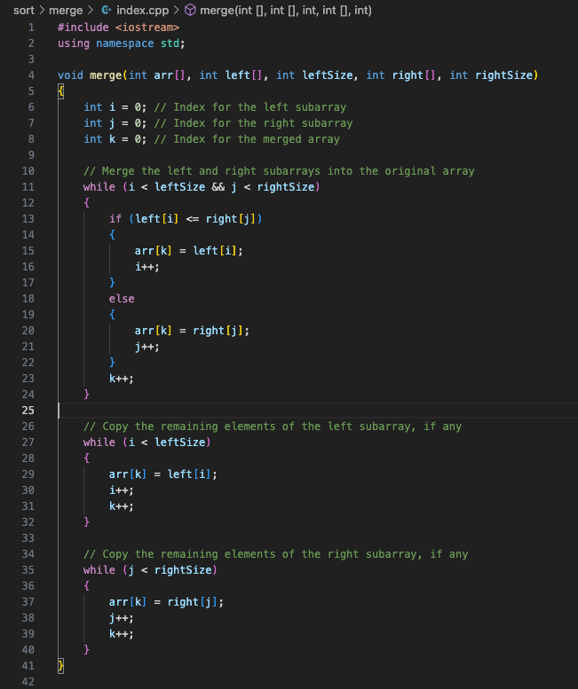
Function declaration:
1
In the merge function, the first while loop is responsible for merging the elements from the left and right subarrays into the arr array in a sorted order.
The loop continues as long as there are still elements to be merged from both the left and right subarrays. The conditions i < leftSize and j < rightSize ensure that the loop terminates when one of the subarrays has been completely merged.
Inside the loop, we compare the elements at indices i and j of the left and right subarrays, respectively. If the element in the left subarray (left[i]) is less than or equal to the element in the right subarray (right[j]), we assign the value of left[i] to the current position in the merged array (arr[k]). We then increment i to move to the next element in the left subarray.
If the element in the right subarray is smaller than the element in the left subarray, we assign the value of right[j] to arr[k] and increment j to move to the next element in the right subarray.
In either case, we increment k to move to the next position in the merged array.
By repeating this process, the loop compares elements from the left and right subarrays and merges them into the arr array in a sorted order until one of the subarrays has been completely merged.
After the loop, there might still be remaining elements in either the left or right subarray. The subsequent two while loops handle the copying of any remaining elements into the merged array.
Let’s first by initializing our code below:
1

Slide 39
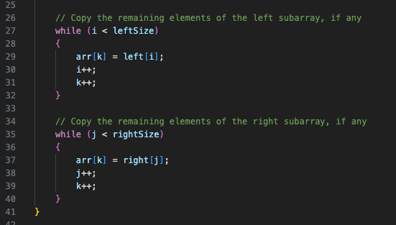

Function declaration:
2
The second while loop is responsible for copying any remaining elements from the left subarray into the merged array arr. This occurs when all the elements from the right subarray have been merged, but there are still some elements remaining in the left subarray.
Inside the loop, we assign the value of left[i] to the current position in the merged array arr[k]. Then, we increment both i (to move to the next element in the left subarray) and k (to move to the next position in the merged array). This process continues until all the remaining elements from the left subarray have been copied into the merged array.
Let’s first by initializing our code below:
2
3
3
The third while loop is responsible for copying any remaining elements from the right subarray into the merged array arr. This occurs when all the elements from the left subarray have been merged, but there are still some elements remaining in the right subarray.
Similar to the second while loop, we assign the value of right[j] to the current position in the merged array arr[k]. Then, we increment both j (to move to the next element in the right subarray) and k (to move to the next position in the merged array). This process continues until all the remaining elements from the right subarray have been copied into the merged array.
dont forget to close the curly brackets
because of these are written in the `merge` function!

Slide 40
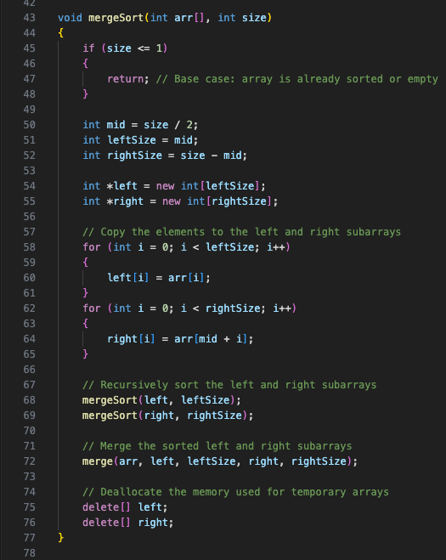
The merge sort declaration:
1
The function starts with a base case check: if (size <= 1). If the size of the array is 1 or less, it means the array is already sorted or empty, so the function returns without performing any further operations.
declaring the main sort function:
2
1
If the base case is not met, the function calculates the middle index of the array using the formula int mid = size / 2. This index is used to divide the array into two halves.
2
3
The function then determines the sizes of the left and right subarrays: int leftSize = mid; and int rightSize = size - mid;
3
4
4
Two dynamic arrays, left and right, are created using the new operator to store the elements of the left and right subarrays, respectively.
5
5
The elements from the original array are copied to the left and right subarrays using two separate for loops. The loop for (int i = 0; i < leftSize; i++) copies the first leftSize elements to the left subarray, and the loop for (int i = 0; i < rightSize; i++) copies the remaining elements to the right subarray.
6
6
The function then recursively calls mergeSort on the left and right subarrays to sort them. This step ensures that each subarray is sorted before merging them back together.

Slide 41
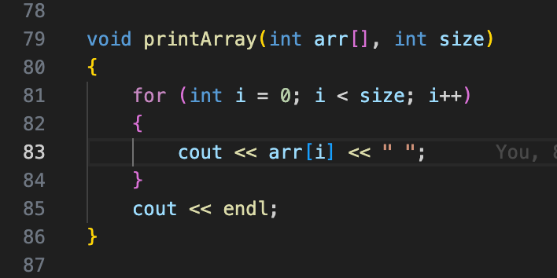
Optional Array printing function:
Again, our favorite but optional function:

Slide 42
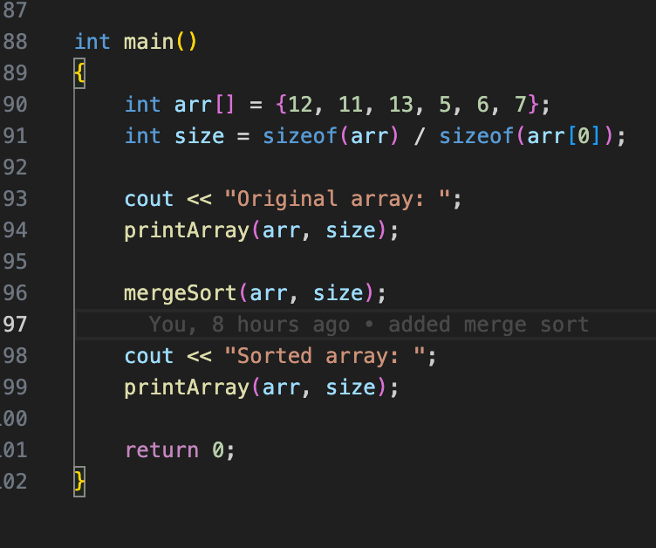
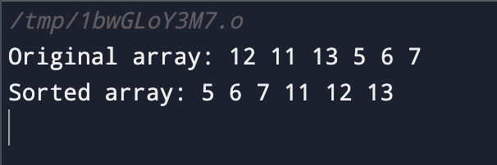
Compilation:
Reveal the magic!
Results:

Slide 43
8. Quick sort
Quicksort is a divide-and-conquer sorting algorithm that works by selecting a pivot element from the array and partitioning the other elements into two subarrays, according to whether they are less than or greater than the pivot. The subarrays are then recursively sorted.

Slide 44
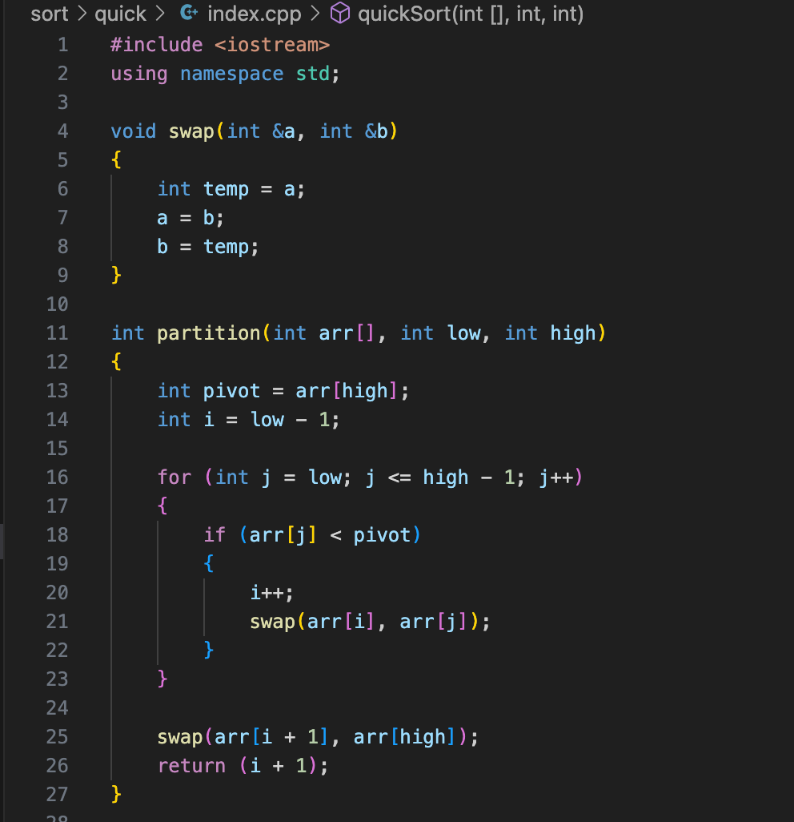
Function declaration:
1
Let’s first by initializing our code below:
We come back too our old swap function again! just like always, takes two integer references (int& a and int& b) as parameters. It swaps the values of a and b using a temporary variable temp. This implementation ensures that the values of a and b are correctly exchanged.
1
2
The partition function is a crucial step in the Quick Sort algorithm as it divides the array into two parts and determines the position of the pivot element. This partitioning process is recursively applied to the subarrays until the entire array is sorted.
2

Slide 45
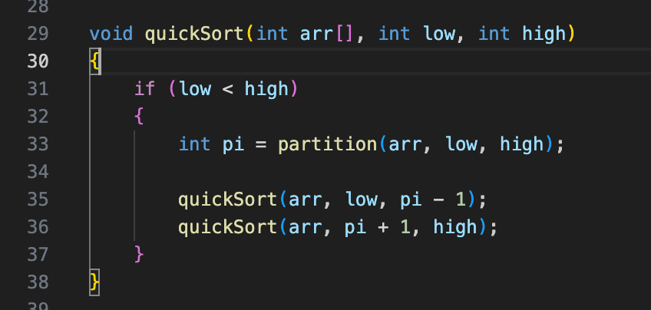
Function declaration:
Our main quick sort function below:
4
It then recursively calls quickSort on the left subarray from index low to pi - 1 to sort the elements smaller than the pivot.
1
5
Similarly, it recursively calls quickSort on the right subarray from index pi + 1 to high to sort the elements greater than the pivot.
2
3
4
5
1
The function takes three parameters: the array arr, the lower index low, and the higher index high.
2
The base case for the recursion is low < high. If this condition is not met, it means the current partition has only one element or no elements, and it doesn't need to be sorted.
3
Inside the function, it calls the partition function to determine the pivot index pi, which partitions the array into two subarrays.

Slide 46
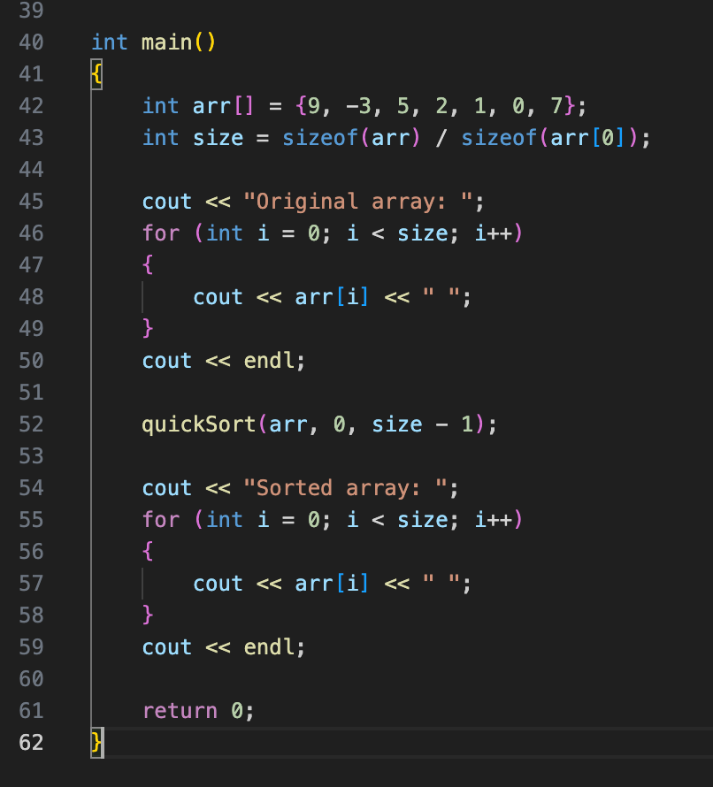
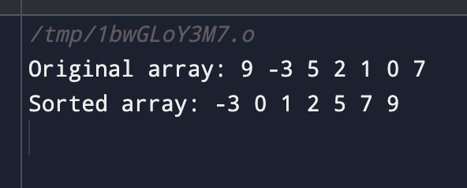
Compilation:
Reveal the magic!
Results:

Slide 47
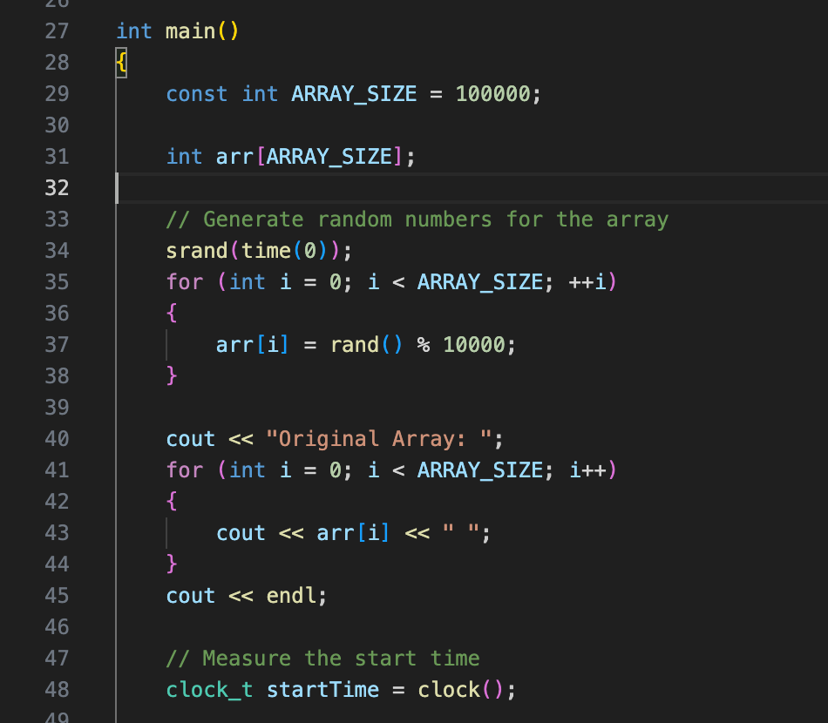
9. Performance Comparison
We will testing the performance of all the mentioned algorithms using the code below:
The code initializes an array with random numbers and measures the start time using the clock() function. This code is typically used for performance testing or benchmarking purposes, where subsequent operations or computations would be performed on the array to measure the time taken for those specific tasks.
We will be using this on each algorithm.

Slide 48
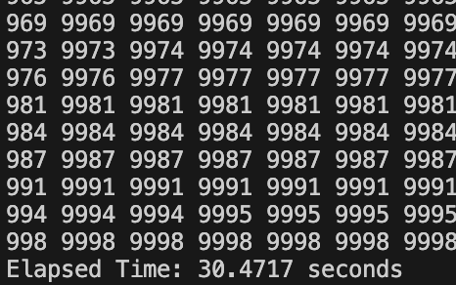
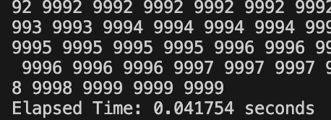
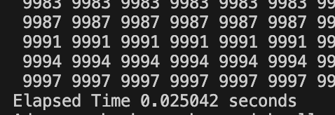
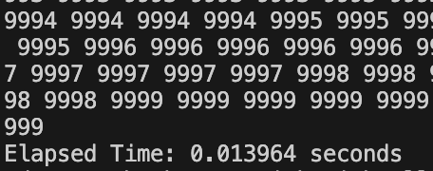
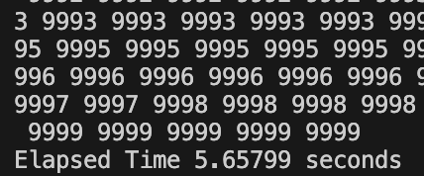
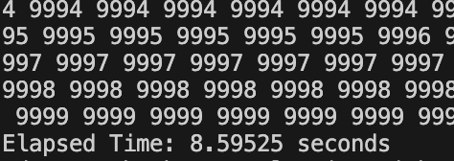
Bubblesort time:
Mergesorts time:
Heapsort time:
Quicksort time:
Insertion sort time:
Selection sort time:
As we can see here, the fastest sorting algorithm among the all of the provided is typically the Quicksort algorithm. Quick sort has an average time complexity of O(n log n), making it more efficient than selection sort and bubble sort which have average time complexities of O(n^2) and bubblesort being the slowest.

Slide 49
10. Best Practices
Bubble Sort:
Use a flag to track whether any swaps were made during a pass. If no swaps were made, the array is already sorted and the algorithm can be terminated early.
Optimize the algorithm by reducing the number of comparisons in each pass. After each pass, the largest element will "bubble" to the end, so you can exclude that element from further comparisons in subsequent passes.
Quicksort:
Choose a good pivot element to achieve better performance. A common approach is to select the middle element of the array as the pivot, but other methods like choosing a random element or using the median-of-three can also be effective.
Consider implementing a different sorting algorithm, such as insertion sort, for small subarrays. Quicksort can have a high overhead for small partitions, so switching to a simpler algorithm when the subarray size is below a certain threshold can improve performance.
To avoid potential stack overflow issues with deeply nested recursive calls, you can use an alternative implementation called tail recursion elimination or use an explicit stack to simulate the recursive calls iteratively.

Slide 50
Selection Sort:
Minimize the number of swaps by keeping track of the index of the minimum element and only swapping once at the end of each pass.
Consider optimizing the algorithm by using two indices, one starting from the beginning and the other starting from the end, to simultaneously find both the minimum and maximum elements in each pass. This reduces the number of comparisons and swaps by half.
Insertion Sort:
Consider implementing a variant of insertion sort called binary insertion sort. Instead of comparing and shifting elements one by one, binary insertion sort uses binary search to find the correct position for the current element, reducing the number of comparisons and shifting operations.
Use early termination if the array is already sorted. Insertion sort is efficient for small arrays and partially sorted arrays, so checking if the array is already sorted can save unnecessary iterations.

Slide 51
Merge Sort:
Implement merging in a separate function to improve code modularity and readability. The merging function should take two sorted subarrays and merge them into a single sorted array.
Consider optimizing the algorithm by avoiding unnecessary memory allocations during merging. Instead of creating temporary arrays for merging, you can allocate a single auxiliary array at the beginning and reuse it for all merge operations.
Heap Sort:
Implement a heapify function to convert an array into a heap data structure before performing the sorting. This function rearranges the elements in the array to satisfy the heap property, which is essential for the heap sort algorithm.
Optimize the algorithm by using a max heap for sorting in non-decreasing order and a min heap for sorting in non-increasing order.
Consider using the standard library's `std::make_heap`, `std::push_heap`, and `std::pop_heap` functions to work with heaps efficiently.

Slide 52
The end.

